Slide 1

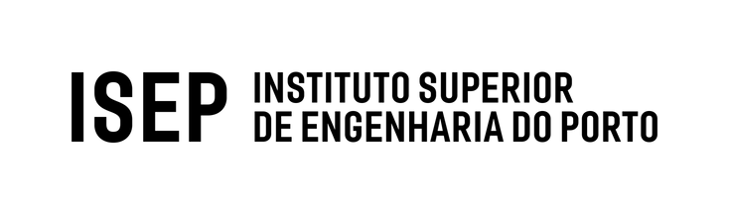
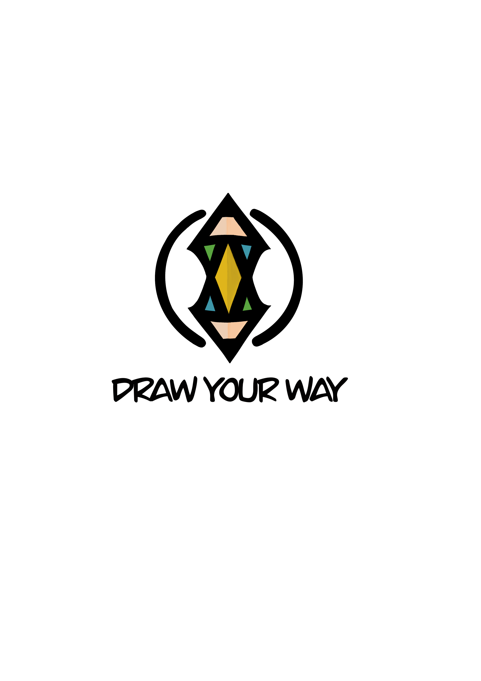
FINAL PRESENTATION
Tim Norrgård
Jouke Klinkenberg
Mateusz Cieśliński
Esther Sala Cao
Victor Van Cauwenberghe
Flavius-Cristian Blanariu

Slide 2
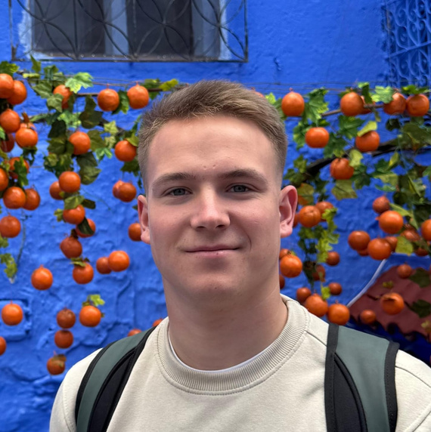
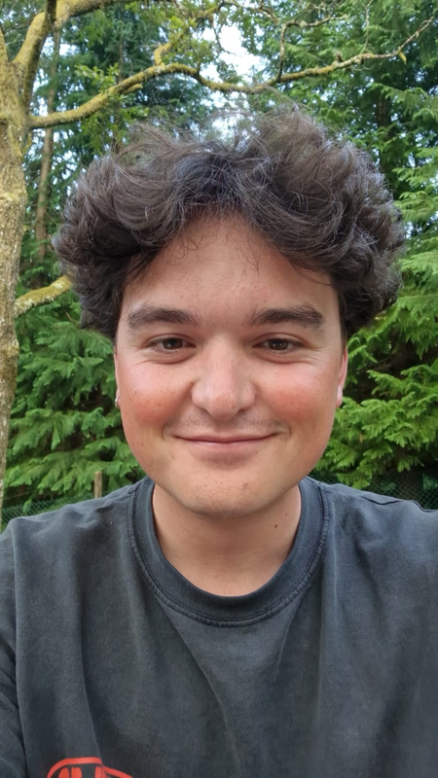
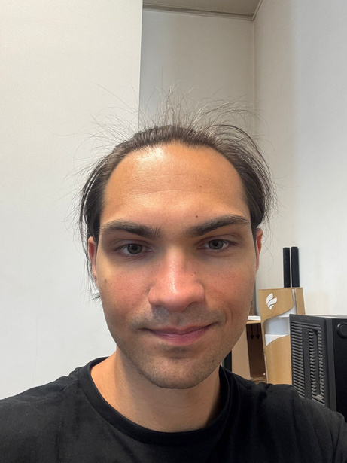
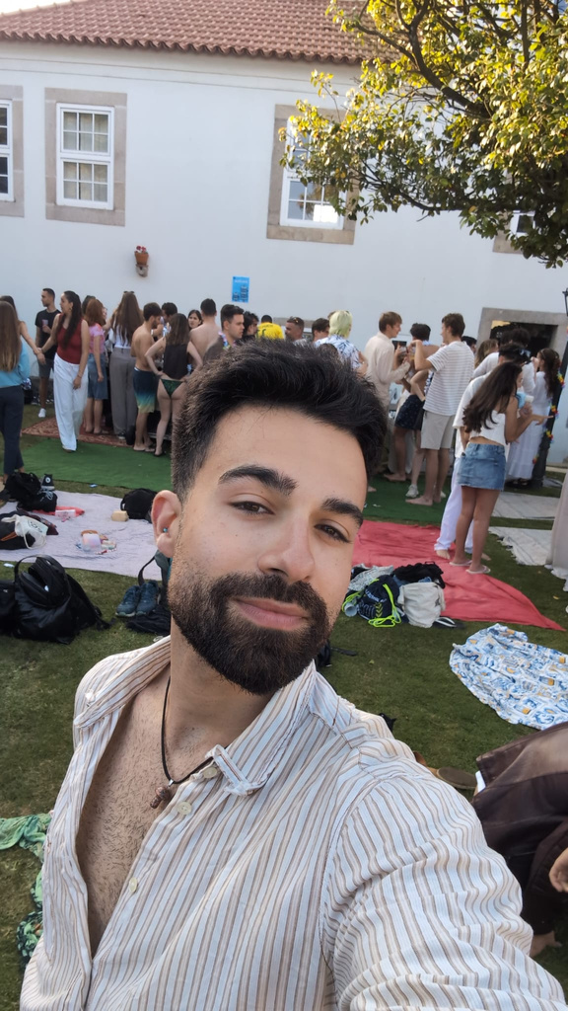
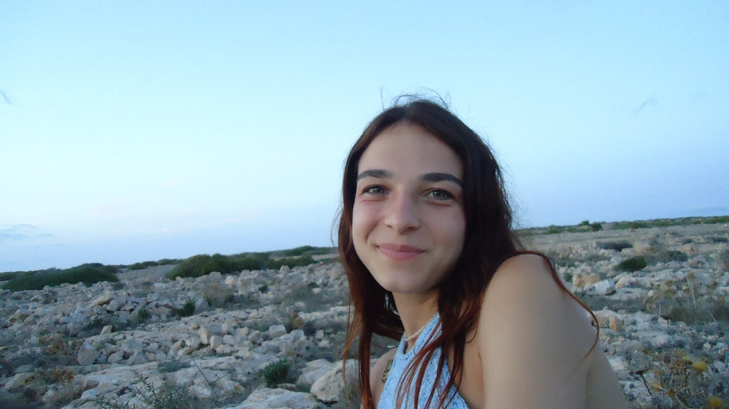
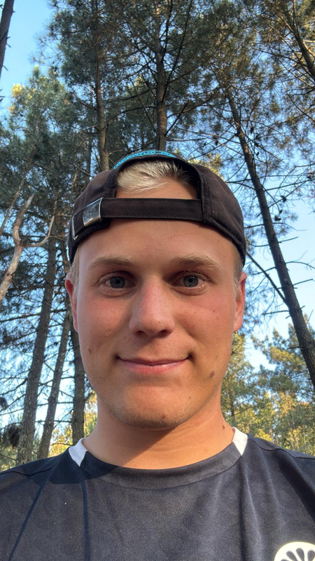
Tim Norrgård
Victor Van Cauwenberghe
Mateusz Cieśliński
Automation engineer
Civil Engineer
Computer Science
Flavius Blanariu
Esther Sala Cao
Jouke Klinkenberg
Industrial Informatics Engineer
Industrial Design Engineer
Mechanical Engineer
2

Slide 3
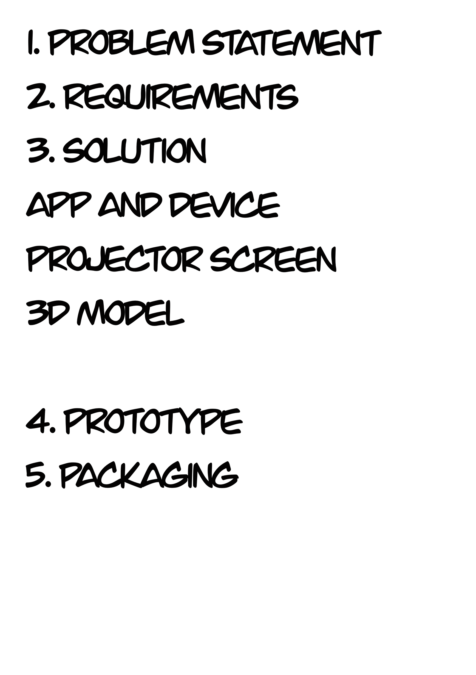

Address the issue of boredom experienced while waiting for public transport.
3

Slide 4
Entertaining
UN sustainable goals
Intuitive use
Innovation
User engagment
Real-time interaction
Digital drawing
+
GREAT FOR PUBLIC USE
=
INTERACTIVE ART IN PUBLIC SPACES
GREAT FOR INDIVIDUAL USE
4
Notes:
State of the art:
• the highest degree of development of an art or technique at a particular time.
I. Applied concepts:
1. Interactive public art;
2. Digital drawing;
3. Projection technology
4. User engagement;
5. Art-is-a-challenge (daily/weekly challenges);
6. Real-time interaction;
7. Sustainability;
8. Public space innovation.
II. Current status analysis:
1. Digital drawing apps (Adobe Fresco, Procreate) - great for individual use, but they don't focus on public collaboration;
2. Interactive screens & Projection systems (Microsoft Surface Hub, Smartboards, Epson Projectors) - interactive but require direct contact with the screen;
3. Interactive art in public spaces (Digital Graffiti projects, Metro Art Screens) - emphasizes real-time interaction and changing themes each week to keep the experience fresh and engaging;
III. Justification for the research & limitations:
1. Finding methods to bring real-time experience;
2. Engaging with large groups of people;
3. Creating community-driven art;
4. Increasing interest in expressing the creativity;
5. Escaping the social media addiction.

Slide 5
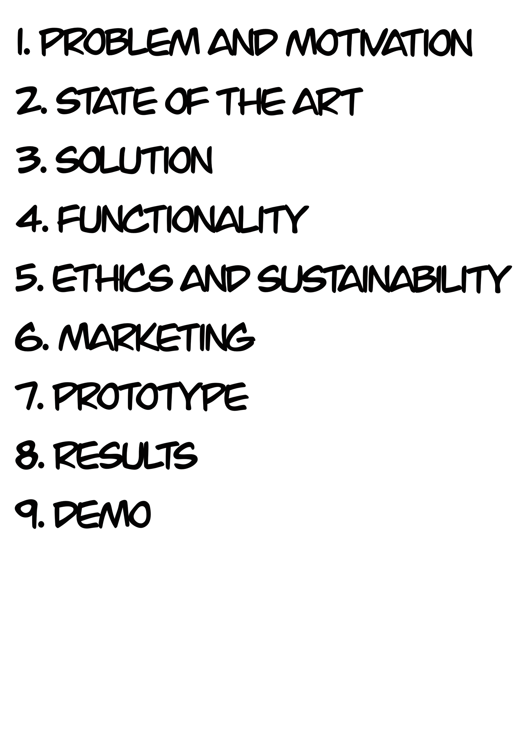
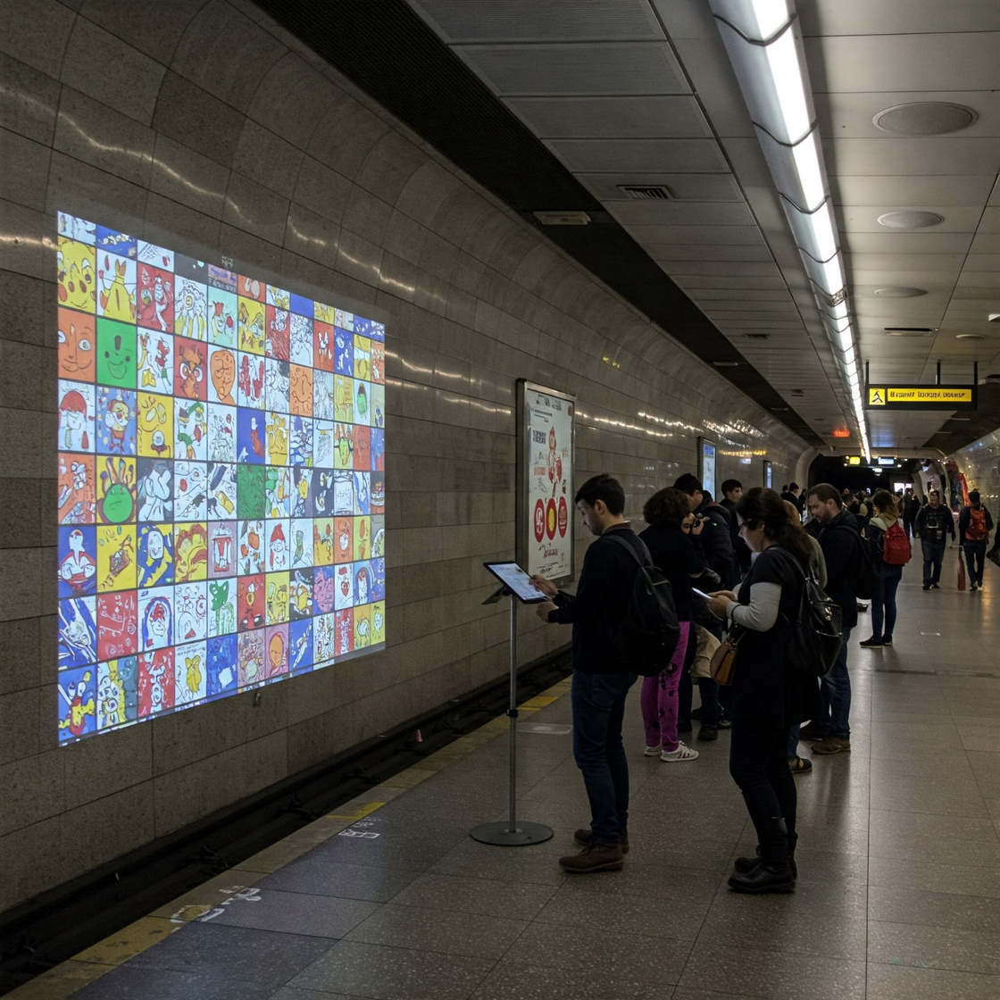
Allow users to draw and create artwork during their waiting time.
5
Notes:
To make waiting at metro stations more enjoyable, we created an interactive art experience. The artwork is then displayed on a projector, this makes the waiting time a fun and creative experience.

Slide 6
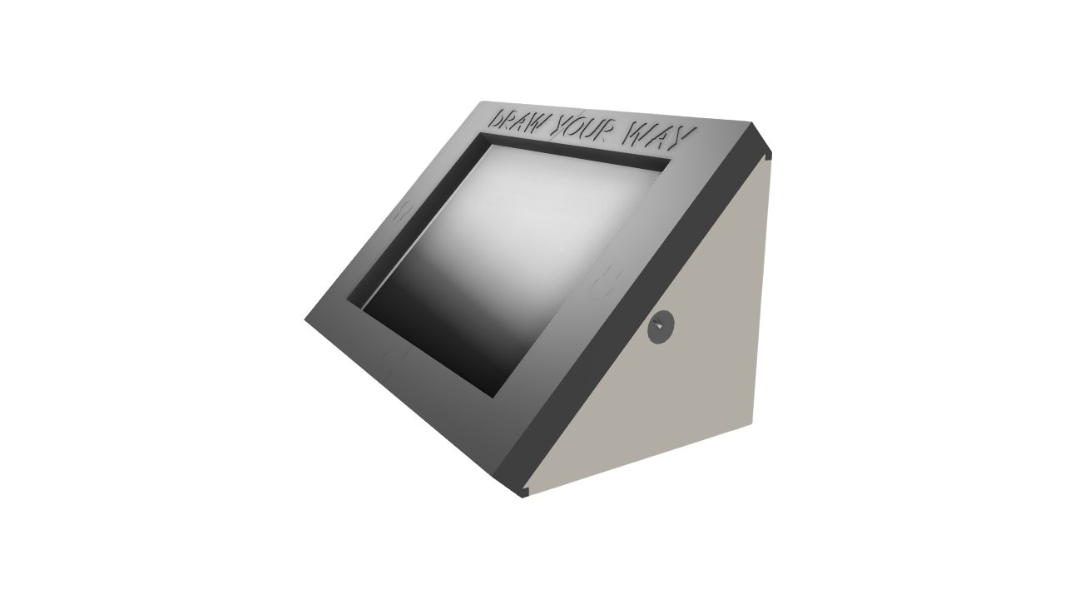
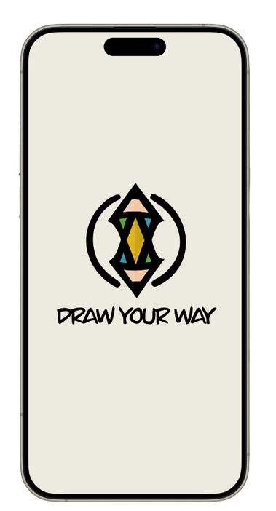
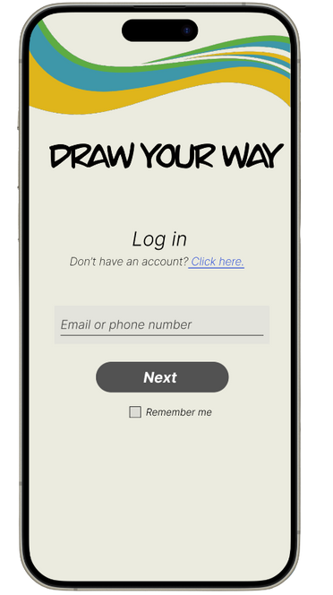
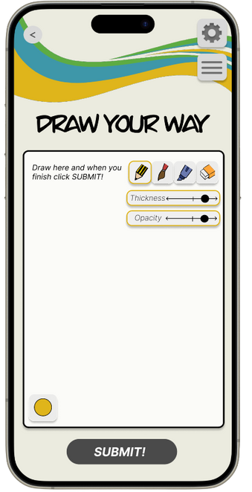
6
Notes:
to be able to interract you can use your phone by scanning the QR code or you can use the tablet with pen in the metro station. First you have to login or create an account. After you finnished the drawing you submit it and it will appear on the screen in the station.

Slide 7
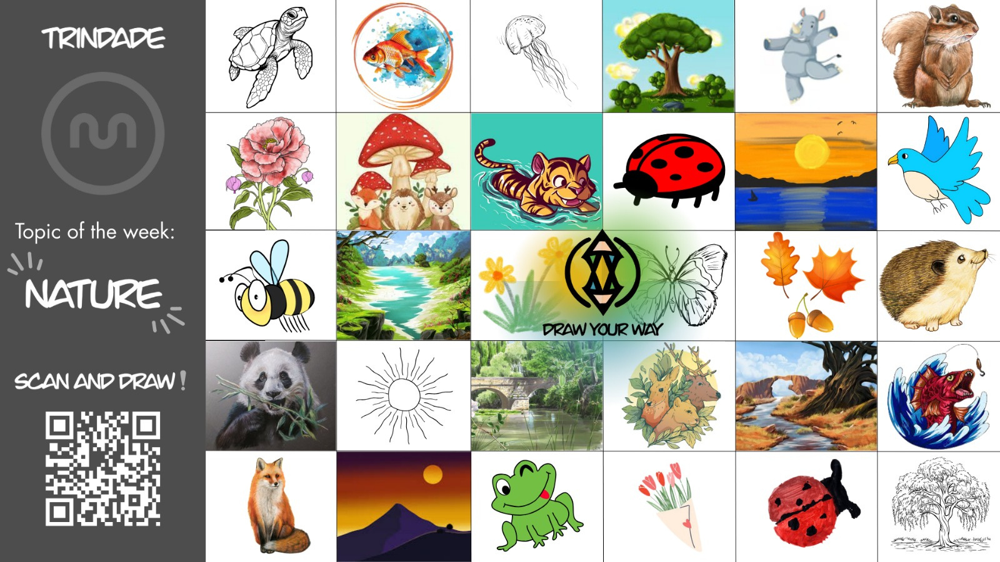
7
Notes:
this is how the screen would look like.

Slide 8
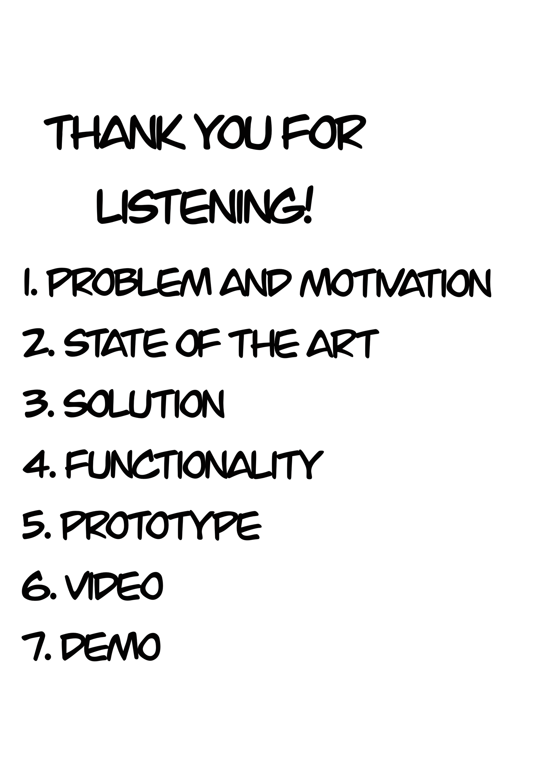
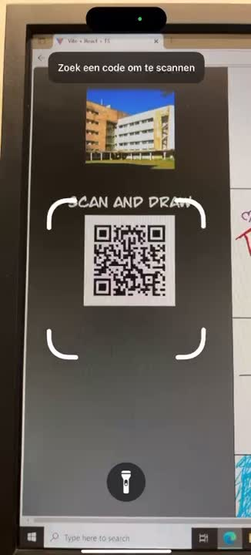
8
Notes:
This is a short Demo video to show how it works on your phone

Slide 9
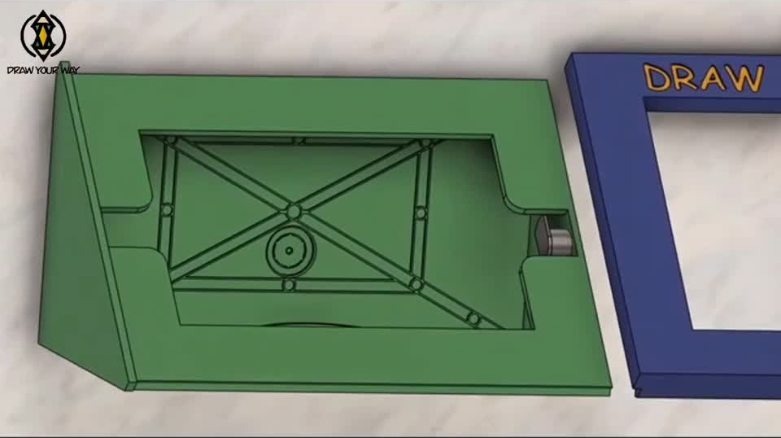
9
Notes:
our Project ethics refers to create a product that is safe, effective, and in line with legal and ethical standards.
Ensure transparency, honesty, and fairness.
and by respecting all users is vital to the success of our inclusive and widely accessible project.

Slide 10
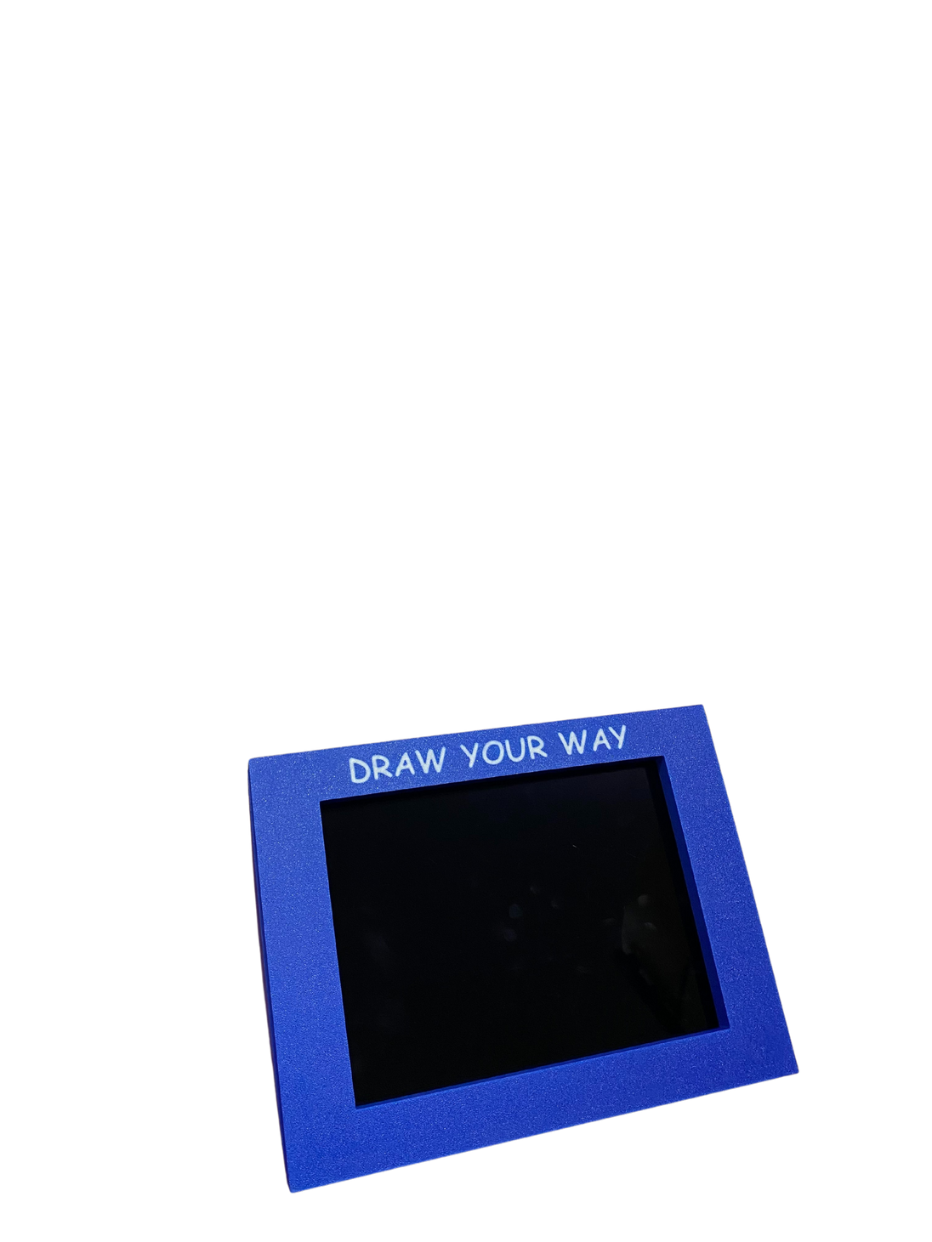
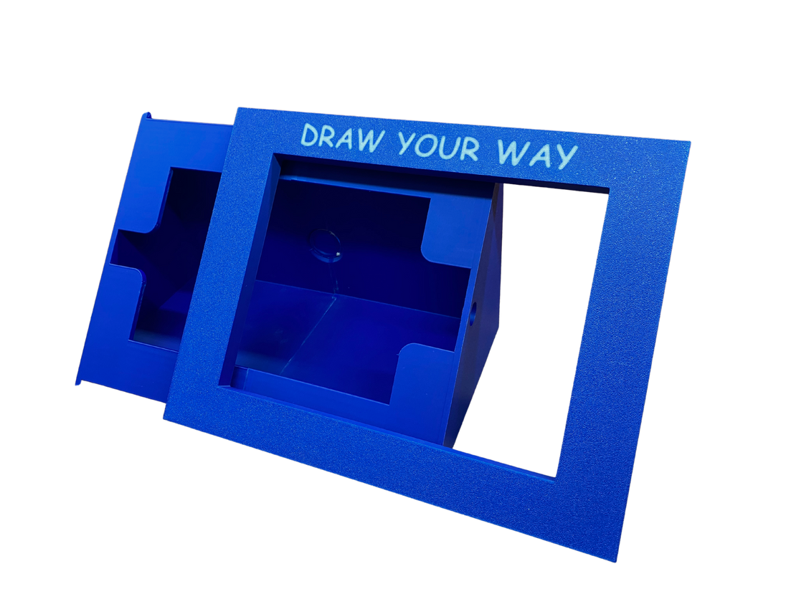
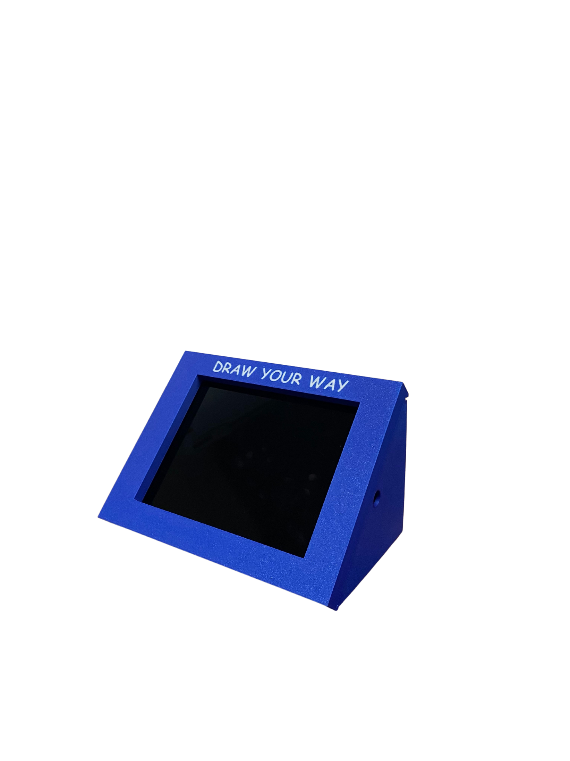
10
Notes:
our Project ethics refers to create a product that is safe, effective, and in line with legal and ethical standards.
Ensure transparency, honesty, and fairness.
and by respecting all users is vital to the success of our inclusive and widely accessible project.

Slide 11
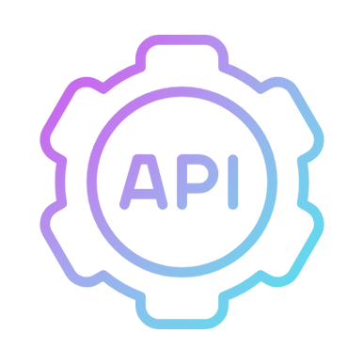


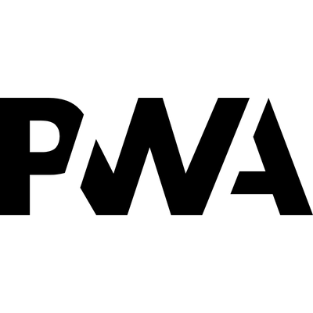


Backend
Communication
Frontend
11
Notes:
our Project ethics refers to create a product that is safe, effective, and in line with legal and ethical standards.
Ensure transparency, honesty, and fairness.
and by respecting all users is vital to the success of our inclusive and widely accessible project.

Slide 12
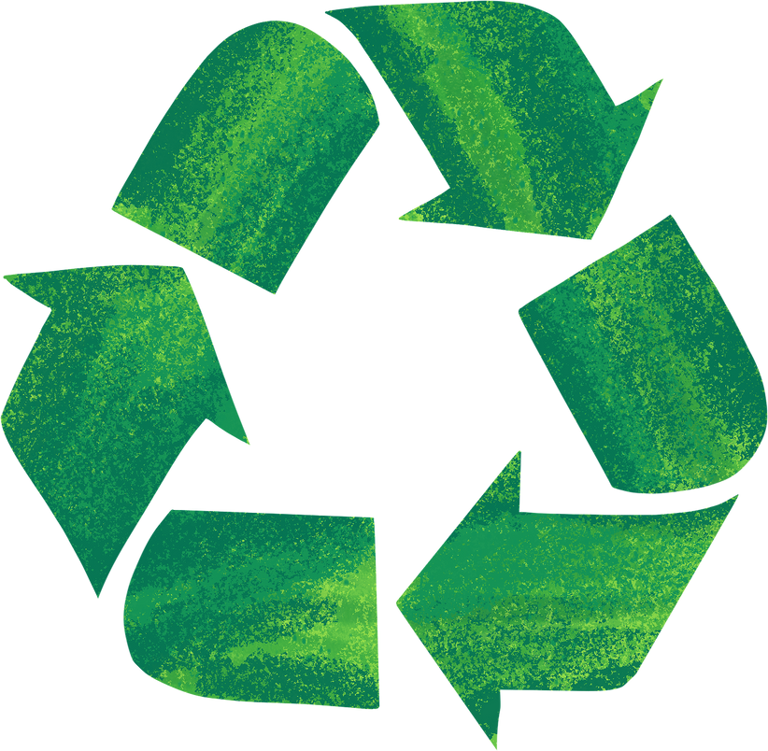
SECOND LIFE
12

Slide 13
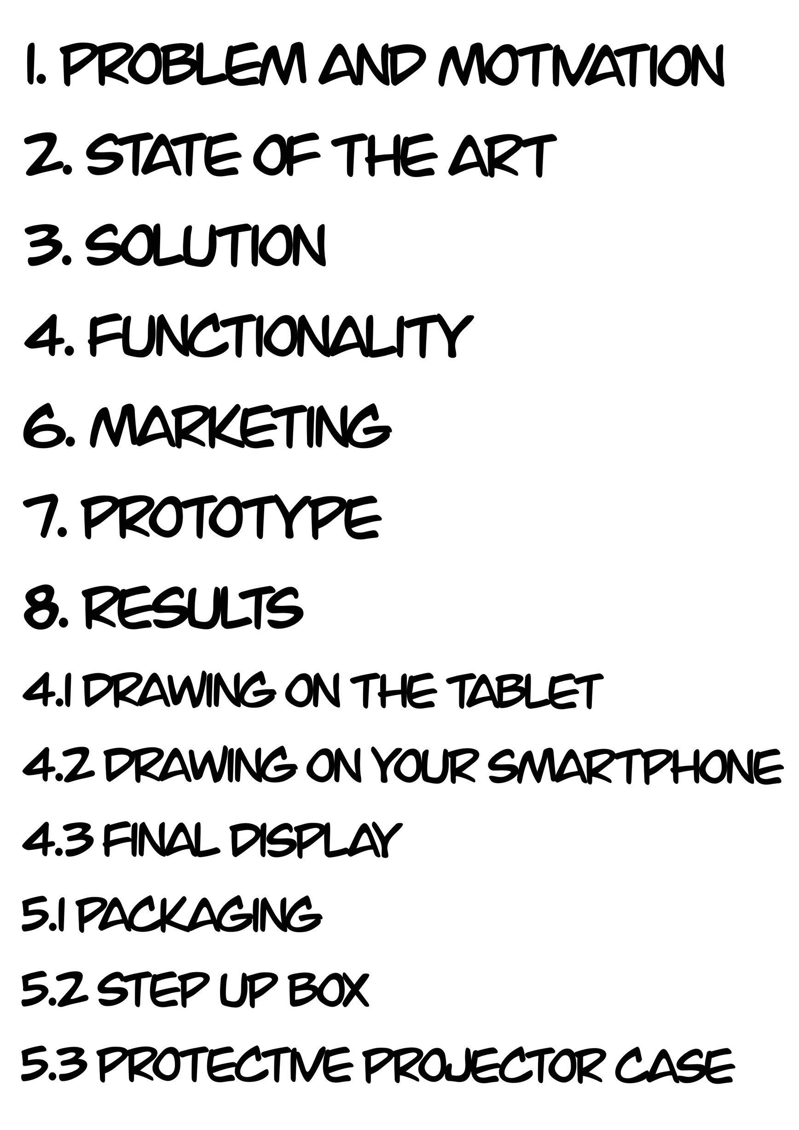
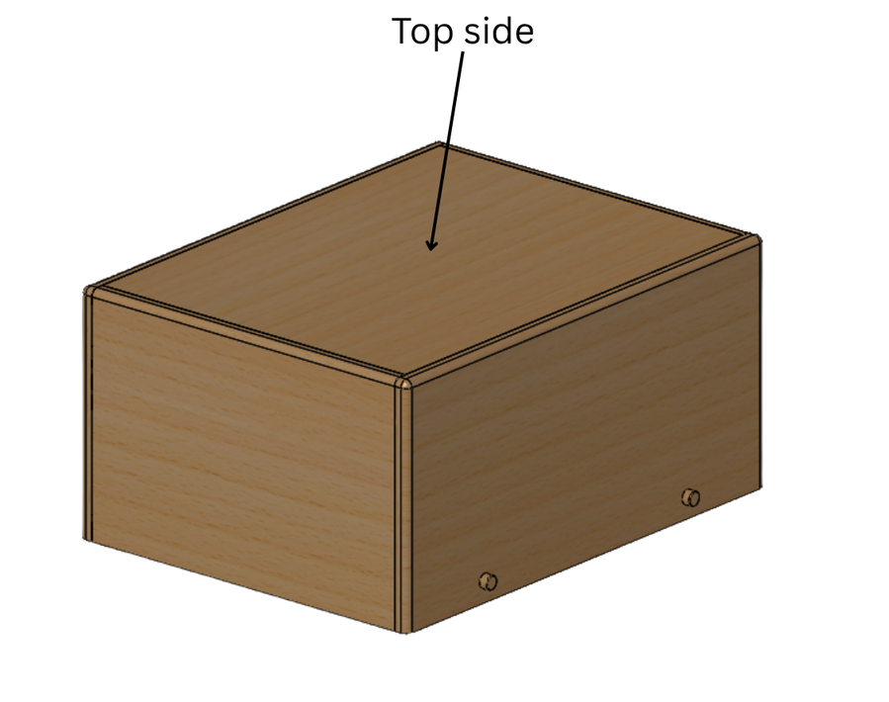
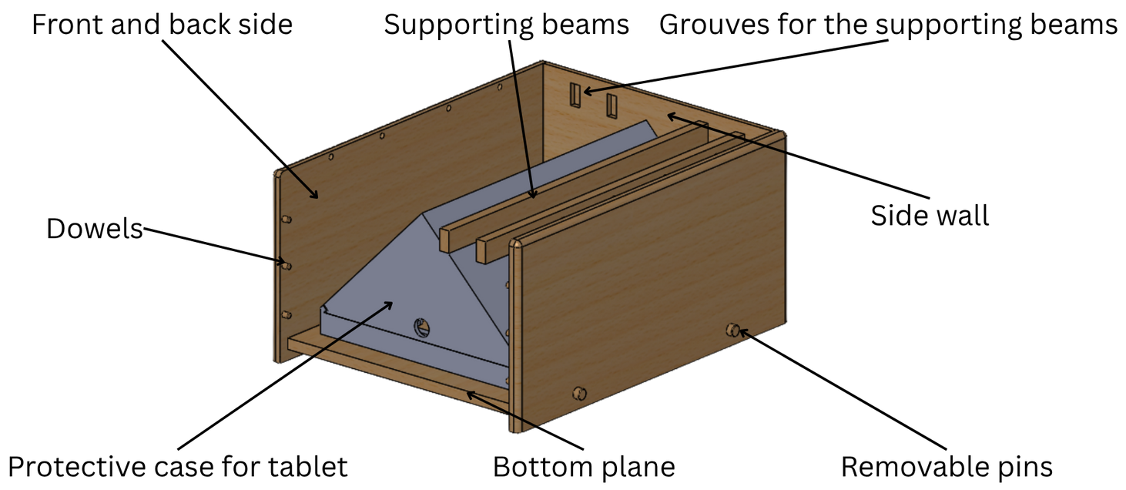
13

Slide 14
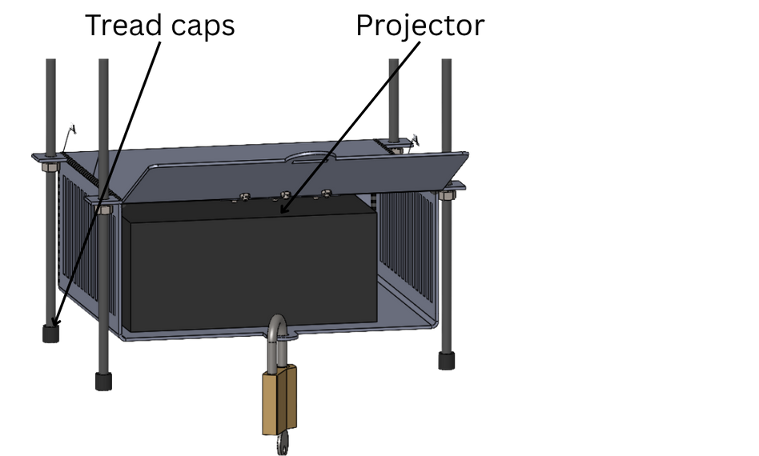
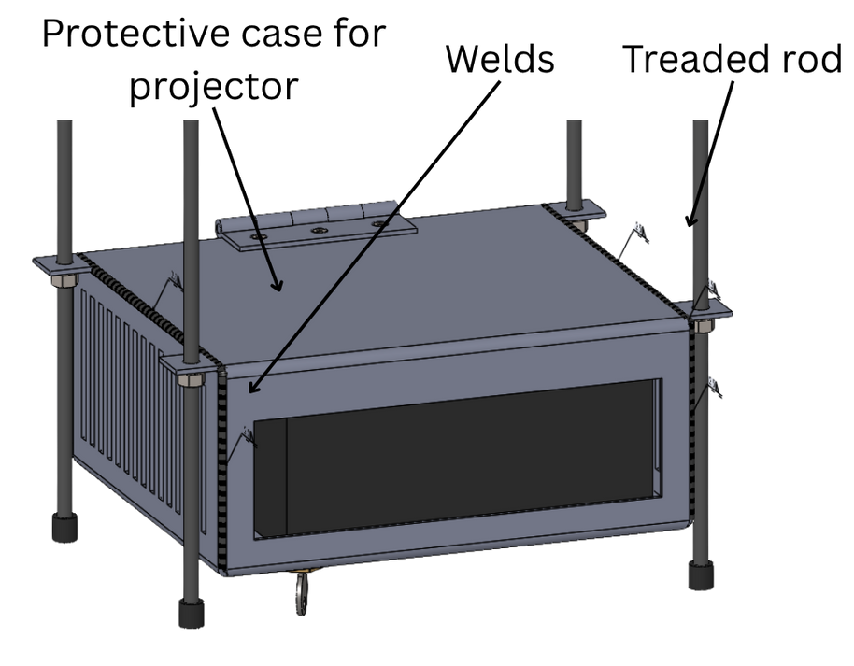
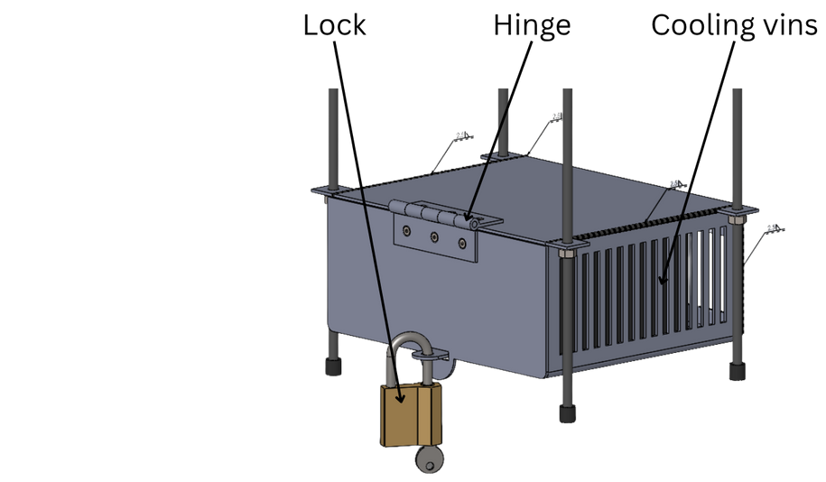
14

Slide 15
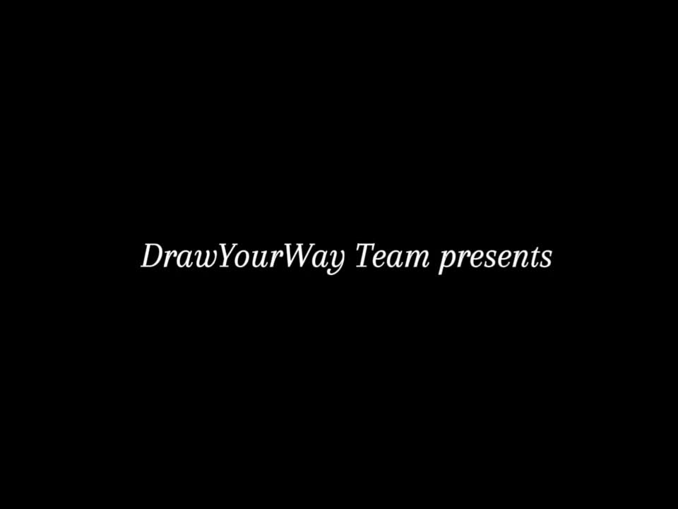
15
Notes:
our Project ethics refers to create a product that is safe, effective, and in line with legal and ethical standards.
Ensure transparency, honesty, and fairness.
and by respecting all users is vital to the success of our inclusive and widely accessible project.

Slide 16
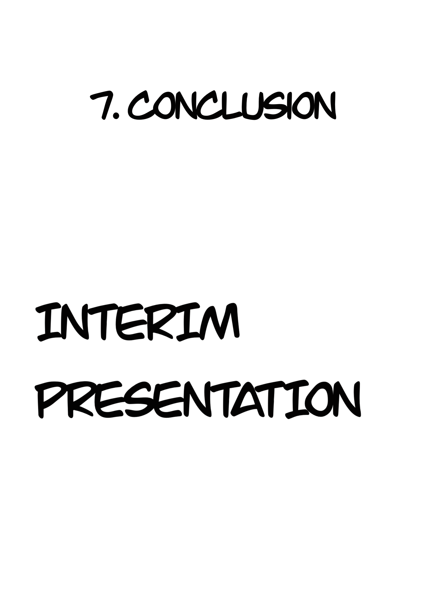
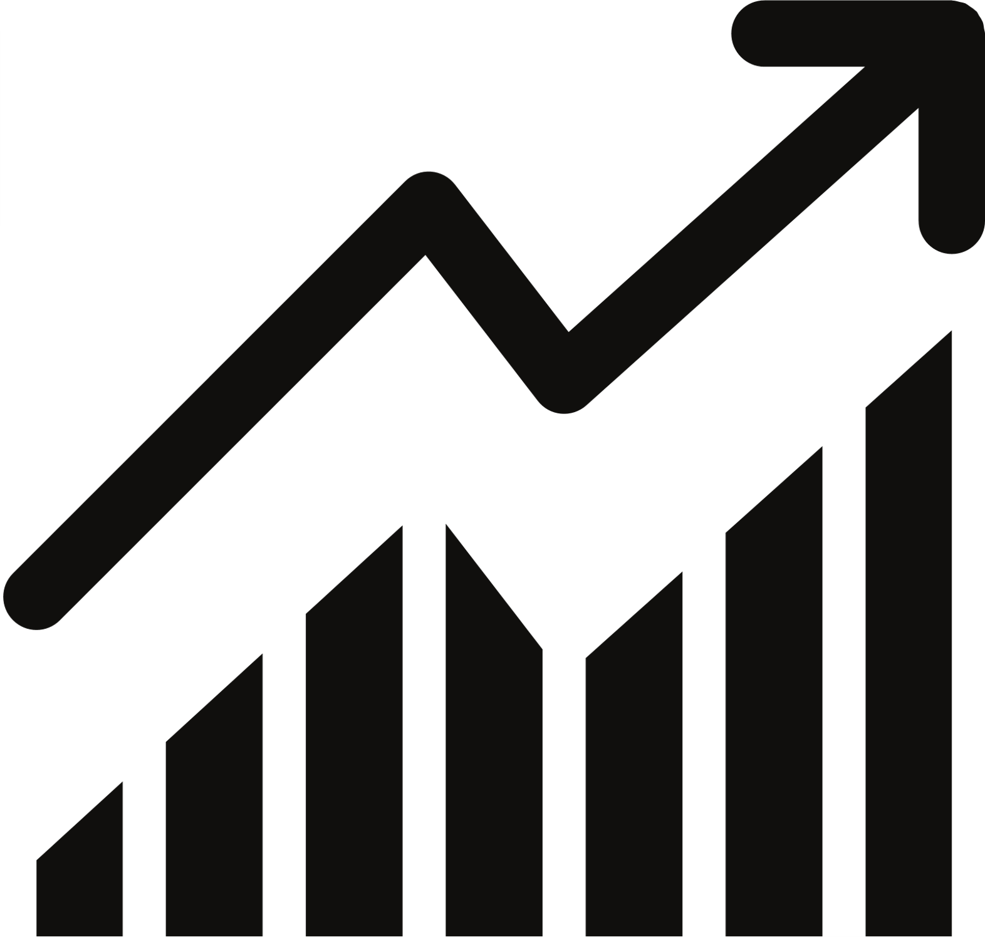


Future Development
Limitations
Achievements
16
Notes:
our Project ethics refers to create a product that is safe, effective, and in line with legal and ethical standards.
Ensure transparency, honesty, and fairness.
and by respecting all users is vital to the success of our inclusive and widely accessible project.

Slide 17
17
Notes:
our Project ethics refers to create a product that is safe, effective, and in line with legal and ethical standards.
Ensure transparency, honesty, and fairness.
and by respecting all users is vital to the success of our inclusive and widely accessible project.

